Slide 1
Swift Street
A Green Careers Week Challenge
Green Jobs for Nature
Swift Street © 2024 by Chartered Institute of Ecology and Environmental Management is licensed under CC BY-NC-SA 4.0

Slide 2
Introduction

Slide 3
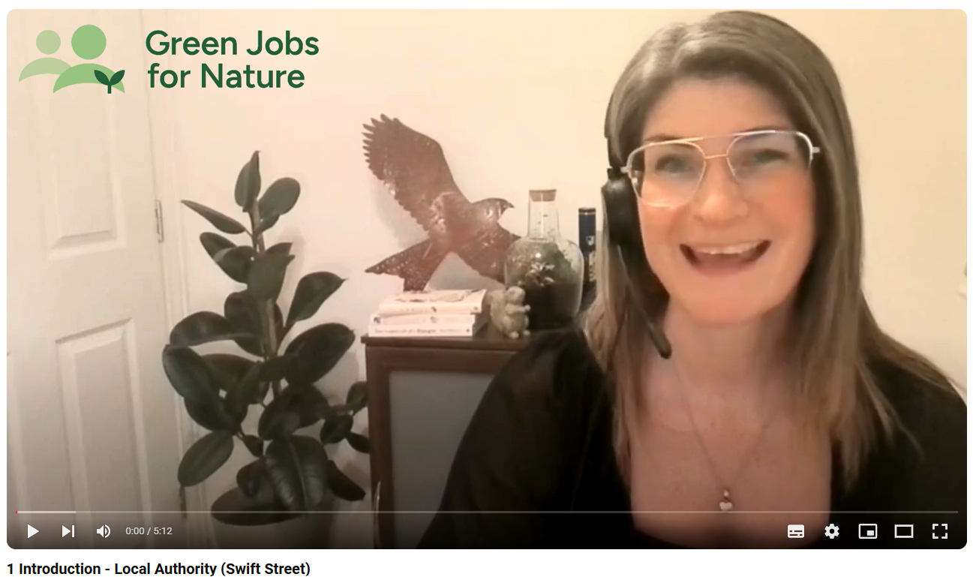
Click here to watch video 1

Slide 4
The Story of Swift Street
On the edge of a quiet residential area lies the forgotten expanse of Swift Street. Once a thriving industrial estate, it now stands as a dilapidated relic, with broken windows and litter telling a tale of neglect. Local residents feel uneasy about its presence but also fear the unknown changes redevelopment might bring.
Despite its current state, Swift Street contains natural beauty. Long grass sways untouched, providing a haven for wildlife. Bats flit through the twilight, and historically, water voles called this place home, though they have since vanished.
Invasive species like American mink and Himalayan balsam have taken hold, the polluted Milton stream cuts through the land. Tarmac patches and bare ground dominate, yet even here, solitary bees and ants thrive.
The industrial park’s closure left a hole in the local economy. Businesses that once relied on the factory workers’ closed, leaving behind a boarded-up cafe and shop. The nearest supermarket is now a considerable distance away. Current use of the land is limited to vandalism and antisocial behaviour, increasing residents’ fears. They long for the area to feel safer.

Slide 5
The Challenge
Over five activities you will meet a range of people carrying out roles that have all helped to contribute to what we know about Swift Street now. They will tell you about the work that they undertook as well as providing advice to you on the final part of the challenge.
It will be down to you to create a media and communications pack in order to help residents understand the changes that are being proposed and what this means for both them and the area.
Task 1
Mapping
Task 2
Species Research
Task 3
Project Budget
Task 4
Events Planning
Task 5
Media
Pack

Slide 6
Task 1
Mapping

Slide 7
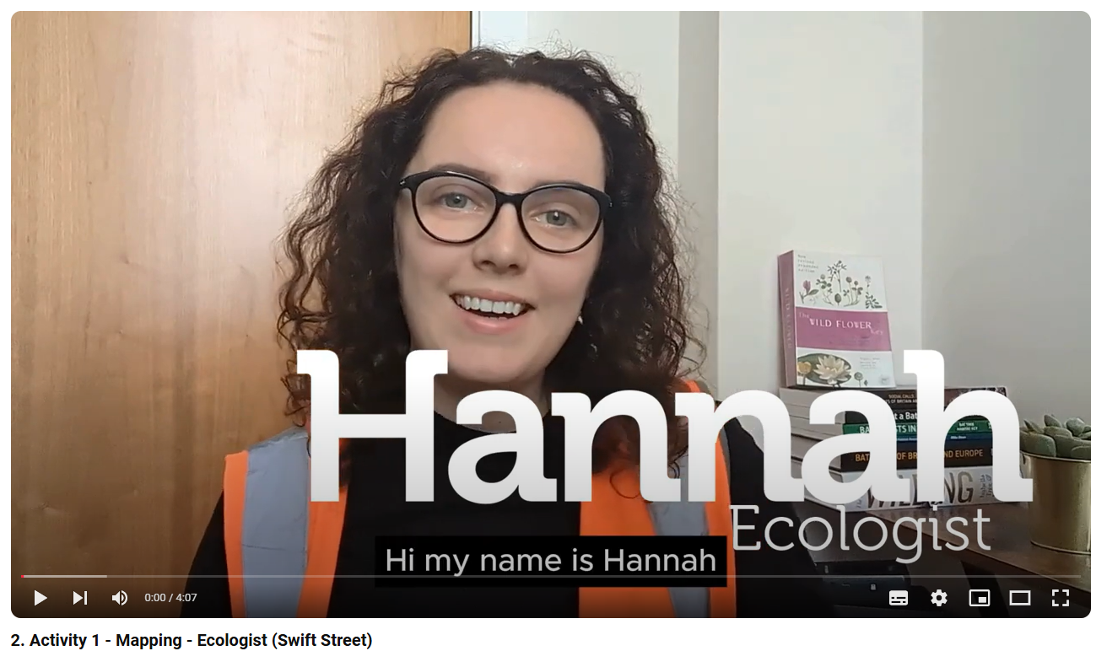
Click here to watch video 2

Slide 8
Ecologist
Activity 1: Habitat Mapping
For this activity you will be studying an area of your school grounds to see what wildlife it might support.
You will be carrying out a habitat survey, this will result in you producing a map of the area you are covering. You need to use coloured pens or pencils to colour parts of the map according to a colour code.
Alongside these habitats, you will also need to record any signs that wildlife might be using the site, this involves you looking for evidence. This might be nests, feathers, and even animal poo.
On your map you can mark these as a red circle with a number in. On a separate piece of paper, record these numbers in a list with a note next to them saying what evidence you have found.
Woodland
(dark green)
Bushes
(light green)
Long Grass
(orange)
Short Grass
(yellow)
Pond
(light blue)
Hedgerow (dark green line)
Running Water
(dark blue)
Bare Ground
(brown)
Buildings
(black)
Fence (black line)
Wall (red line)
Colour Code for Mapping

Slide 9
What do they do?
Study how environmental changes affect species. Some ecologists focus on specific groups like mammals or freshwater plants.
What do they use?
Knowledge of species identification. Tech’ such as drones, bat detectors & thermal imaging. Computer software to write & present reports.
Salary
£20k to £42k
Ecologist
Getting an ecologist job
NVQ Level 3
Apprenticeship
Ecology or environmental degree

Slide 10
Task 2
Species Research

Slide 11
Click here to watch video 3

Slide 12
Environmental Adviser
Activity 2: Species Research
For this, you will need to carry out research into species of interest and concern in order to find out more about them and their behaviour and how they are typically managed.
Several species of interest have been found at Swift Street, in groups you will need to research one of these species and present your findings on these. You have been asked to consider how Swift Street could be changed to support the species that you have researched.
The species of interest are:
Earthworms
Water Vole
Beaver
Hedgehog
Bats
Once you have created your ideas, you will be required to present them to the rest of your class, so choose a spokesperson from your group!

Slide 13
What do they do?
Help people and organisations, including farmers, businesses and local authorities, manage their land and development projects in ways that protect and enhance nature.
What do they use?
Data analysis software, Geographic Information Systems (GIS) databases & project management software
Salary
£25 to £50k
Environmental Advisers
Getting a job in environmental advising
NVQ Level 3
Apprenticeship
Ecology or environmental degree

Slide 14
Task 3
Project Budget

Slide 15
Click here to watch video 4

Slide 16
Conservation Ranger
Activity 3: Project Budget
Now that you have heard from the Conservation Ranger you will need to consider the budget that you have available and how you will manage this in order to have the greatest impact whilst balancing the concerns of the local residents.
Review the costs of different conservation activities (e.g., tree planting, pond digging) and discuss which activities you would prioritise within the budget.

Slide 17
Conservation Ranger
Residents Current Concerns
From a survey of 300 residents
165 people are concerned about frequent vandalism in the area.
70% of people do not feel safe walking around the area after dark due to the antisocial behaviour.
150 people are unhappy with the amount of litter and waste accumulating around the estate.
40% of people believe the abandoned buildings are an eyesore and contribute to a feeling of neglect.
90 people are worried that the derelict state of the estate is harming local wildlife.
35% of people are concerned that the presence of the disused estate is negatively affecting property values in the neighborhood.
40% of people believe the area lacks safe and accessible community spaces for families and children.
Activity 3a: Find out which concerns are most common. Convert all the figures into percentages by dividing the value (number of people) by total value (number of people surveyed), multiply the result by 100.
For example, 150 unhappy with the amount of litter out of a survey of 300: 150/300 = 0.5 x 100 = 50%

Slide 18
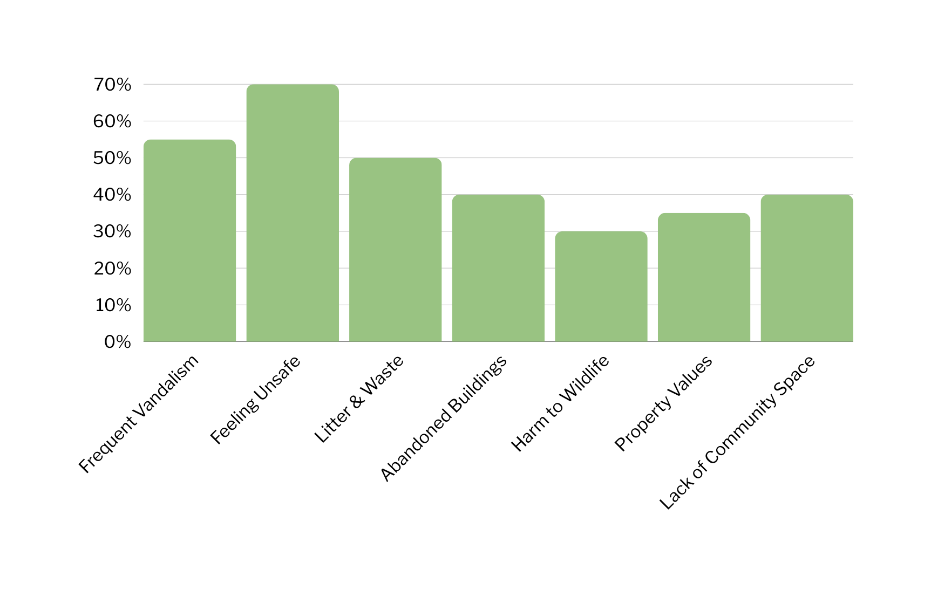
Conservation Ranger
Activity 3a: Residents Current Concerns
70%
55%
50%
40%
40%
35%
30%

Slide 19
Conservation Ranger
Activity 3b: Residents Future Concerns
From a survey of 300 residents
75 people feel development might erase aspects of the areas industrial heritage
45% of people are concerned that the change in use will lead to increased noise levels
50% of people are concerned about the impacts on parking for residents
150 people are worried about the antisocial behaviour being pushed into nearby areas
105 people are worried about disturbance to the wildlife that is now living in the disused estate
Activity 3b: Find out which concerns are most common. Convert all the figures into percentages by dividing the value (number of people) by total value (number of people surveyed), multiply the result by 100.

Slide 20
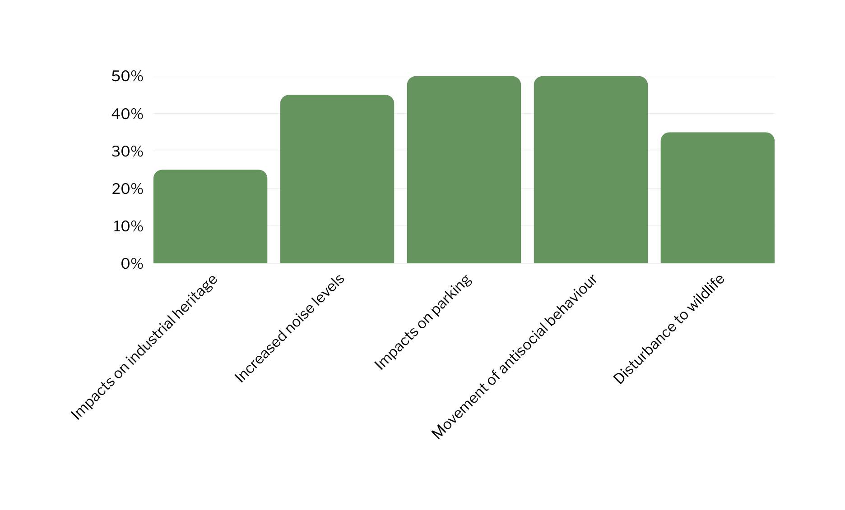
Conservation Ranger
Activity 3b: Residents Future Concerns
50%
50%
45%
35%
25%

Slide 21
Conservation Ranger
Activity 3c: Budgeting
Species Rich Hedgerow, with tree guards £14 per m:
1000m = £14,000
500m = £7,000
250m = £3,500
Wildlife Pond: £25,500
Pond Dipping Platform: £4,000
Wildflower Meadow:
Large (8% of the entire area) = £75,000
Medium (4% of the entire area) = £37,500
Small (2% of the entire area) = £15,000
Cost of “rewilding” Milton Stream: £20,000
Cost of bat and bird boxes: £80 per box (including installation)
Cost of bench: £600 (including installation)
Cost of information panels: £500 (including installation)
Cost of accessible pathway: £100 per m:
500m = £50,000
250m = £25,000
100m = £10,000
Now that you have heard from the Conservation Ranger you will need to consider the budget that you have available (£125,000) and how you will manage this in order to have the greatest impact whilst balancing the concerns of the local residents.
Review the costs of different conservation activities (e.g., hedge planting, pond digging) and discuss which activities you would prioritise within the budget.
To help with some of your decisions, the distance around the perimeter of the site is approximately 1000m.

Slide 22
What do they do?
Protect animals & plants by managing habitats on nature reserves, private estates, or coastal areas & they often speak to visitors too.
What do they use?
Practical skills, tools & machinery.
Manage livestock to maintain sites.
Salary
£18k to £30k
Conservation Ranger
Getting a conservation worker job
NVQ Level 2 or 3
Apprenticeship
Ecology or environmental degree

Slide 23
Task 4
Events Planning

Slide 24
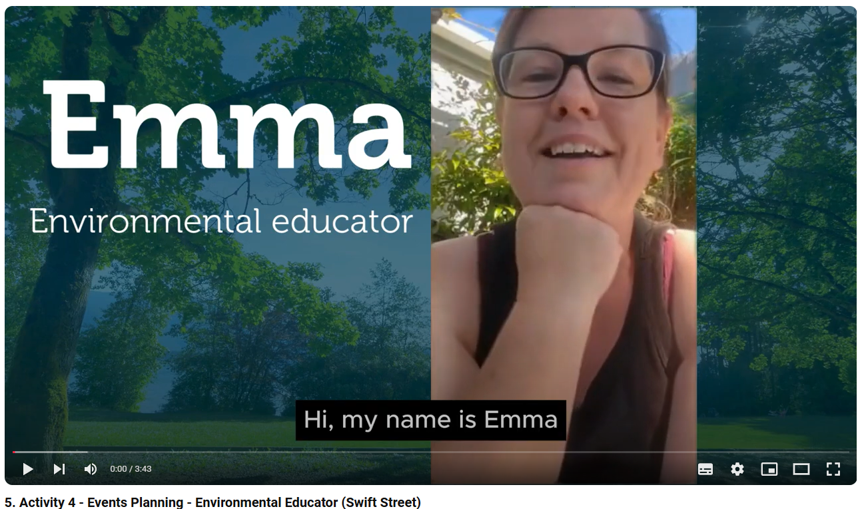
Click here to watch video 5

Slide 25
Environmental Educator
Activity 4: Events Planning
As a group, discuss what benefits humans could get from urban nature reserves and parks. When you have decided, start to write them into the segments of your wheel (you have 15 mins)

Slide 26
Benefits of urban parks to humans
(also known as Ecosystem Services)
Reduce air pollution
Stores carbon
Controls temperature (cooling effect)
Increases property values
Vegetation can reduce noise
Vegetation can reduce flooding
Contributes to positive mental and physical health
Encourages social interactions

Slide 27
What do they do?
Help people learn about the natural world, its importance, and how to protect it.
What do they use?
Communication skills
Educational resources
Salary
£20k to £30k
Environmental Educator
Getting a job in environmental education
NVQ Level 2 or 3
Apprenticeship
Ecology or environmental degree
Teaching Qualification

Slide 28
Task 5
Media Pack

Slide 29
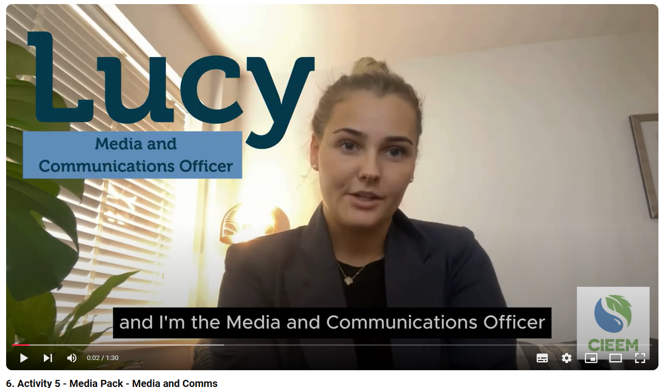
Click here to watch video 6

Slide 30
Your Role - Media and Comms
Activity 5: Media Pack
You will be taking on the role of Media and Communications and we need you to produce a media pack that includes:
A brief social media post that highlights the benefits of the project (minimum 250 words)
Design an A4 sized poster or leaflet with key visuals that support the message

Slide 31
What do they do?
Help represent conservation and environmental causes to the public and act as a crucial way of spreading information and advocating for the natural world.
What do they use?
Cameras, editing & graphic design software, social media platforms, content management systems.
Salary
£20k to £50k
Media and Communications
Getting a job in media and communications
NVQ Level 2 or 3/T-Levels
Apprenticeships
National Council for Training Journalists Qualifications
Degrees in Journalism, Media Studies etc

Slide 32
Activity 5: Media Pack Tips
Use maps as visuals to showcase biodiversity in your poster
Use what you've learned about the needs of different species and habitats to help explain your ideas for protecting the environment
Highlight what you’re proposing to do on a limited budget
Use your Ecosystem Service Wheel to showcase the environmental and social benefits
Connect the activities, i.e. link species in Activity 1 with the habitat needs from Activity 2 and conservation strategies from Activity 3
Give a vision for the future - what do you expect the site to be like?
Consider who the audience is and what they care about when designing your social media post and poster

Slide 33
Summary

Slide 34
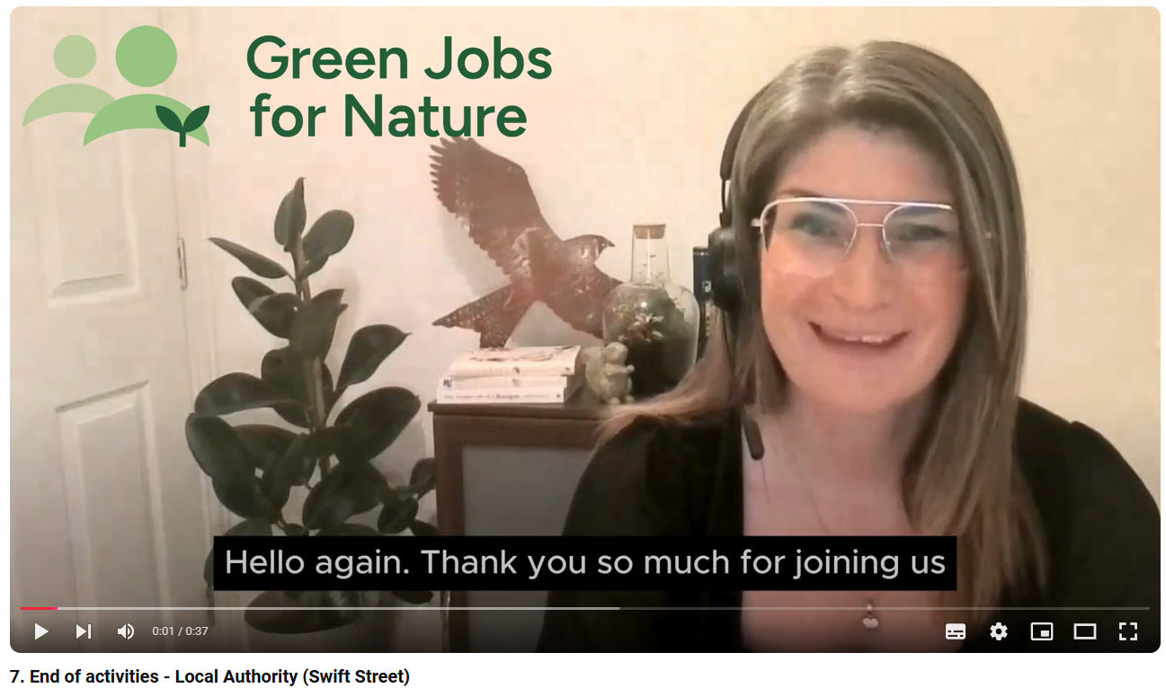
Click here to watch video 7

Slide 35
Glossary

Slide 36
DEFINITION
EXAMPLES
Blackbird
Common Frog
Daisy
Water Vole
A group of organisms that can breed together to produce fertile offspring
SPECIES
Common Frogs are one of the UK’s Amphibian species
ILLUSTRATION
A SENTENCE USING THE WORD

Slide 37
DEFINITION
EXAMPLES
Pond
Woodland
Heathland
Grassland
River
The area in which an animal, or plant, naturally lives
HABITAT
The habitat of a Sand Lizard, is heathland
ILLUSTRATION
A SENTENCE USING THE WORD

Slide 38
DEFINITION
EXAMPLES
Diversity of habitats
Diversity of species
Diversity within species
The variety of life in an area (i.e. the number of species in one place)
BIODIVERSITY
Biodiversity is vital for supporting life on Earth & is the foundation of all healthy ecosystems
ILLUSTRATION
A SENTENCE USING THE WORD

Slide 39
Annex 1
Wildlife Information
(to support Activity 2)
Contents
(UK) Bat Species
Beavers
Earthworms
Hedgehog: An Overview
Plant communities and their role in biodiversity
Swifts
Water Voles

Slide 40
(UK) Bat Species: An Overview
Common Pipistrelle
Call Frequency: 45 kHz
The UK's smallest bat, weighing as little as a 2p coin. It can eat up to 3,000 insects in a single night!
Soprano Pipistrelle
Call Frequency: 55 kHz
Slightly smaller than its common cousin, the soprano pipistrelle prefers wetlands and water bodies where it can find abundant insects.
Bats are important animals in our environment. The UK has 18 types of bats, each with special traits.
Why Bats Matter
Bats in the UK are protected by law because their numbers are dropping due to habitat loss, pollution, and human activity. Protecting bats helps keep nature balanced and controls insects.
How To Help
You can help bats by putting up bat boxes, avoiding pesticides, and keeping natural areas safe. Organising bat walks also helps spread the word.
Daubenton's Bat
Call Frequency: 35-85 kHz
Often referred to as the "water bat," Daubenton's bat skims over water surfaces to catch insects, using its large feet and tail membrane.
Noctule
Call Frequency: 20 kHz
One of the UK's largest bats and can often be seen flying high in the early evening before sunset, unlike most other bat species.
Greater Horseshoe Bat
Call Frequency: 80 kHz
Easily recognisable by its horseshoe-shaped noseleaf, which it uses to focus its echolocation calls. It’s one of the rarest bats in the UK, mainly found in the southwest
Brown Long-eared Bat
Call Frequency: 25-45 kHz
Known for its large ears, which are nearly as long as its body, this bat has excellent hearing and can even detect the rustle of insect wings.
Body
Images: © Hugh Clark / www.bats.org.uk

Slide 41
Beavers
What They Do:
Beavers build dams and lodges with branches, mud, and stones, creating wetlands. These wetlands support many other animals and plants. Beavers eat tree bark, leaves, and aquatic plants, and their work helps clean water and boost biodiversity.
How to Help:
Create Habitats: Ensure there are streams or ponds for beavers to build in. Plant native trees like Willows and Poplars.
Protect Their Environment: Keep water clean and avoid harming their habitat.
Spread the Word: Educate others on how beavers benefit ecosystems by reducing flooding and improving water quality.

Slide 42
Earthworms
What They Do:
Earthworms help keep soil healthy by aerating it, breaking down organic matter, and recycling nutrients. They feed on dead plant material and organic debris, boosting soil fertility.
How to Help:
Create Habitats: Add compost or leaf litter to keep soil healthy. Avoid compacting the soil.
Avoid Chemicals: Reduce or eliminate chemical fertilizers and pesticides.
Provide Food: Add organic materials like dead leaves and grass clippings.
Educate Others: Share tips on supporting earthworms and conserving soil.

Slide 43
Hedgehog: An Overview
What They Do:
Hedgehogs are beloved UK mammals known for their spiny coats. They are in decline, with numbers dropping by about 50% since 2000 due to habitat loss, pesticides, and road traffic.
How to Help:
Create Hedgehog Highways: Make small holes
(13 x 13 cm) in fences for easy movement.
Provide Shelter: Leave parts of your garden wild and add hedgehog houses.
Avoid Pesticides: Cut down on pesticides to protect their food supply.
Raise Awareness: Spread the word about hedgehog conservation and involve schools and community groups.

Slide 44
Plant Communities and Biodiversity
Woodlands, grasslands, wetlands, and hedgerows are crucial for biodiversity. They form essential food chains and provide shelter and breeding sites for many animals.
Supporting Biodiversity:
Food Chains: Plants feed herbivores like Water Voles and Beavers, which in turn feed predators such as birds of prey and Foxes.
Shelter and Breeding: Dense vegetation provides crucial homes and breeding spots for various species.
Woodlands are full of plant diversity and support wildlife in many ways.
Trees offer roosting sites for Bats and their insects, while dense undergrowth and leaf litter provide food and shelter for Hedgehogs.
Grasslands are lively habitats with rich soil full of worms. Worms help aerate the soil and are a key food source for many animals.
These areas also provide excellent foraging grounds for Hedgehogs, who eat the abundant insects.

Slide 45
Plant Communities and Biodiversity
Wetlands, like marshes and ponds, are crucial for water-dependent species. Beavers build dams that boost plant diversity and create habitats for other animals. They also provide food and burrowing sites for Water Voles, supporting healthy aquatic plant communities.
Hedgerows connect different ecosystems and support rich, healthy soil with many worms. They provide important navigation routes and feeding grounds for Bats, which hunt insects here. They also offer safe travel routes and food for Hedgehogs and other animals, helping reduce predation and road accidents.

Slide 46
Swifts
What They Do:
Swifts are expert flyers, reaching speeds up to 69 mph and spending almost their entire lives in the air. They migrate thousands of miles from Africa to the UK each year to breed. Swifts help control insect populations, eating thousands of insects like mosquitoes and flies every day, which benefits both humans and other animals.
A Swift in flight
How to Help:
Put up Swift boxes on buildings for safe nesting.
Protect their nests during the summer.
Plant wildflowers and avoid pesticides to support insect populations.
A Swift nesting box

Slide 47
Water Voles
What They Do:
Water Voles are great swimmers and eat a variety of plants. They used to be common in the UK but have drastically declined, now missing from 94% of their former habitats. The main threat is the American Mink, which preys on Water Voles.
How to Help:
Maintain vegetation: Keep the edges of streams and rivers wild or fenced off to provide food and cover.
Remove Artificial Banks: Take away artificial barriers to create natural burrowing spots.
Survey Regularly: Check for Water Voles between April and June to help track their numbers.

