Slide 1
How the Environment Agency assesses permit applications
Habitats and ammonia
Rick Gould, Ellie Stubbs and Judith Ford

Slide 2
Outline
Background
Emissions sources of ammonia and pattern of emissions
The installations that we regulate under the IED
How we assess permit applications
Detailed modelling and assessment
The models used – strengths and weaknesses
Model validation
Measured versus modelled results
Sources of uncertainty
Current challenges
Case law, thresholds, headroom (or capacity)

Slide 3
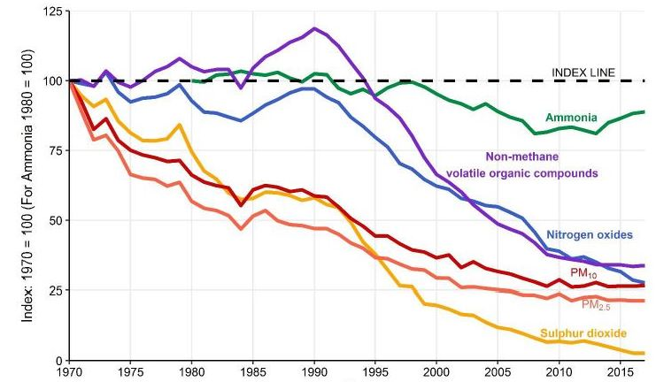
2019 onwards - The Clean Air Strategy
Source: NAEI

Slide 4
Ammonia, its sources, proportions and impact assessment

Slide 5
Sources of ammonia
Animal waste
Urea-based fertilisers
Nitrogen in faeces and urine
Vehicle deNOx
Industrial deNOx
Urea injection
Chemicals production
Waste decomposition
Fertilisers

Slide 6
Ammonia emissions by sectors
Industrial Emissions Directive – larger pig and poultry farms only – place for 40,000+ birds, 2000 ‘production pigs’ over 30kg and/or 750 sows.

Slide 7
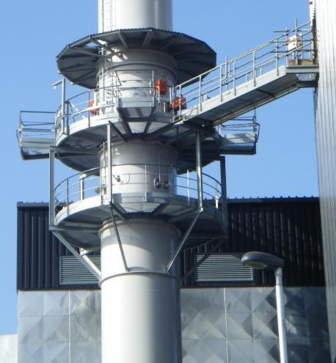
Industrial emissions - apply BAT
Smaller energy generators:
More of them, e.g. biomass boilers, MCPD installations
NOx control using urea injection – risk of ammonia emissions

Slide 8
The assessment process

Slide 9
The process of assessment
Compare with critical levels
Compare with critical loads
Mass
emissions
Screening
Ground
Level
Concentrations,
C_{n}
Installation type, size and emissions factors; habitat proximity
Estimate
Deposition
(C_{n} x v x t x area)
Dispersion modelling
Impact
Assessment
We audit all modelling reports submitted with permit applications. The AQMAU audit a selection, i.e. those that need extra scrutiny. We have a risk-based process for selecting which applications go to AQMAU and those which are review by NPS
9

Slide 10
Source-pathway-receptor
NO2, NH3
NO₂
NOx
NH₃
NH₃

Slide 11
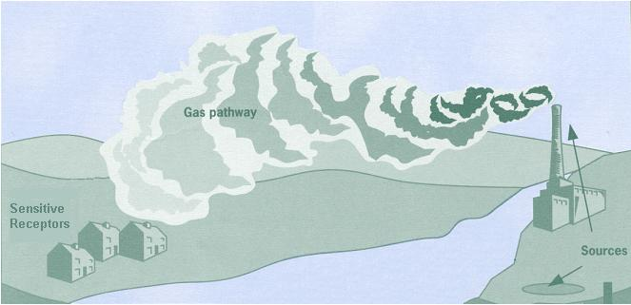
Source-pathway-receptor

Slide 12
Dispersion models
Screening models
SCAIL Ag/Combustion
Detailed modelling
ADMS
SCAIL = ‘AERMOD Lite’
Ammonia Screening Tool (AST)
AERMOD
Depend on user-skill, and representative topographical / meteorological data
Range up to 15km
National modelled results, e.g. FRAME for ammonia, APIS for critical loads

Slide 13
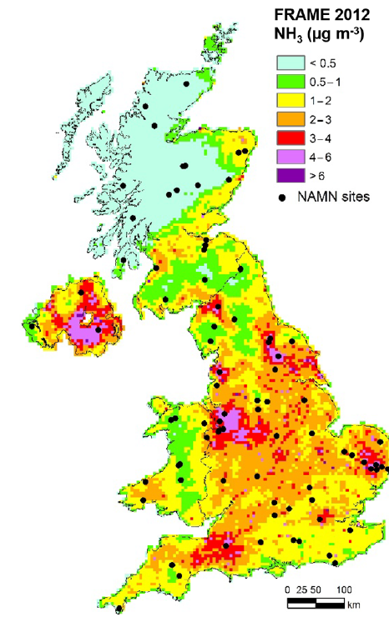
Take into account background
Source: CEH

Slide 14
Golden rules of modelling
Screening-model results - must be higher than detailed modelling results
Detailed modelling results must be validated for representative situations. Predicted ~ Measured results

Slide 15
Screening models
S
AST and SCAIL Ag (in conservative mode) set up the wind to be always blowing towards the habitat, all of the time.
S
S
H
S
S
S

Slide 16
Strengths and limitations of models
Indicative
Predictive
‘Crystal ball’ for concentrations and deposition
Conduct sensitivity analyses
Indicative
Uncertainties - approximations to reality
Input data uncertainties: source data - emission rates, meteorological data, terrain
Validation/uncertainty ~ 0.7–1.3x (Long Term) 0.5–2.0x (Short Term)

Slide 17
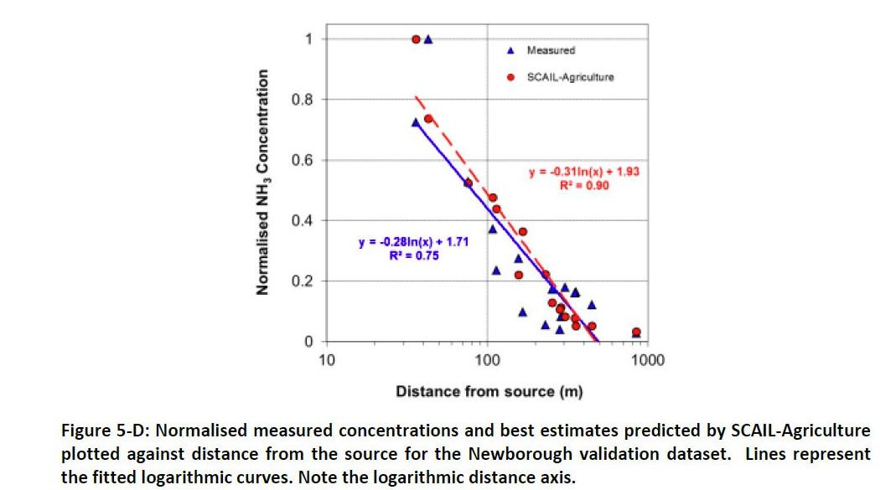
Model validation
Source: Sniffer ER26 - Final Report - March / 2014

Slide 18
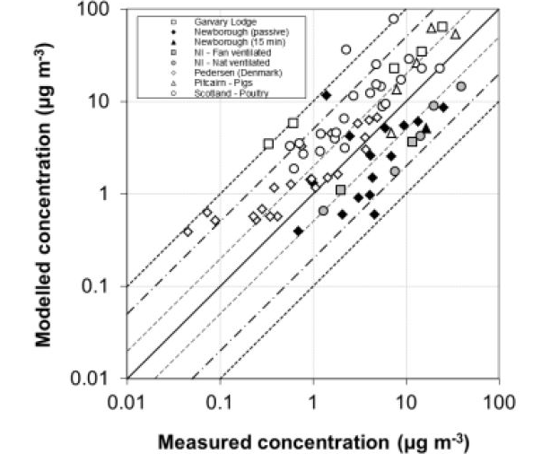
Model validation
Source: Sniffer ER26 - Final Report - March / 2014

Slide 19
Lessons from validation exercises
The model output is only as good as the data fed into the model
Caution – when extending the validated range
Biggest source of uncertainty – the emissions factors, especially for intensive farming
Emissions factors for single-point sources are relatively easy to determine
Emissions from intensive farms have many variables that are often difficult to measure

Slide 20
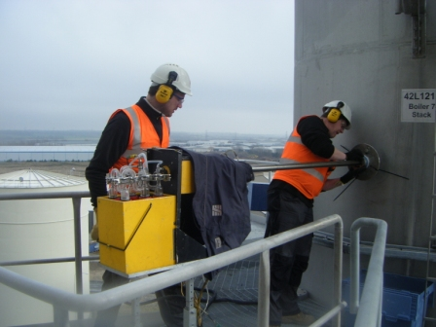
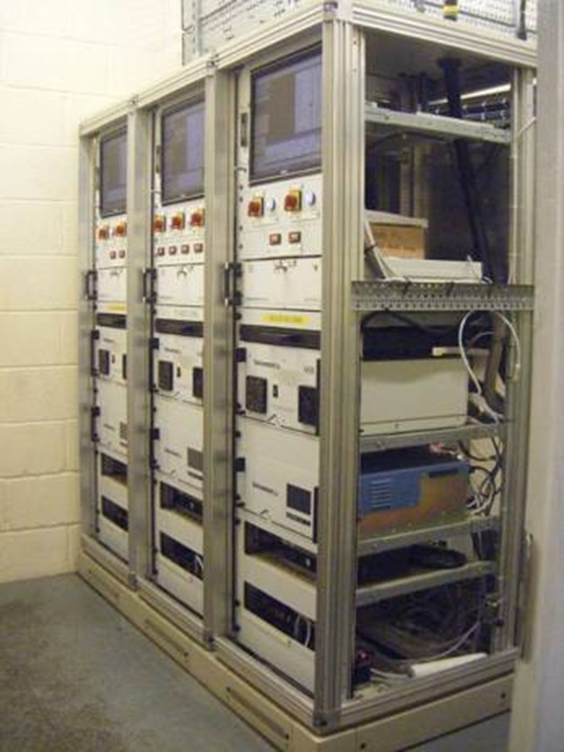
Emissions factors for single-point sources
Continuous monitoring with certified instruments calibrated and verified
Reference monitoring using accredited test laboratories using certified equipment and validated EN standards

Slide 21
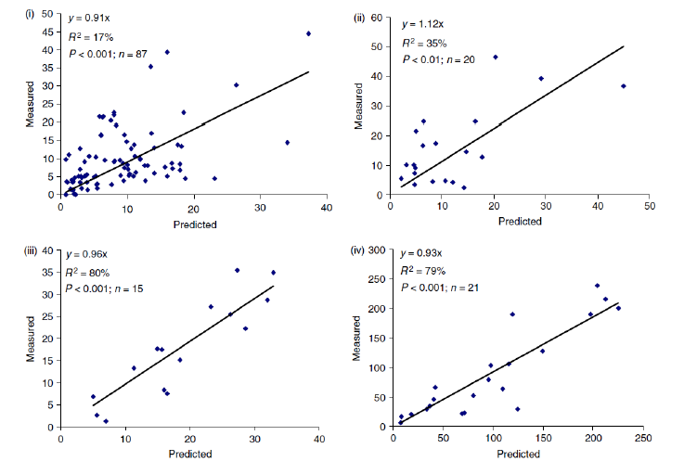
Emissions factors for diffuse sources
Source: Inventory of Ammonia Emissions from UK Agriculture, 2017, for DEFRA, by Misselbrook & Gilhespy

Slide 22
Current challenges

Slide 23
Current challenges
Dutch Nitrogen Case
Wealden Judgement
Growth Duty, polarised interests
Emissions factors
Thresholds
In combination assessments

Slide 24
The Wealden Catch-22
Planned road
Existing road
Protected habitat

Slide 25
Wealden
Individual sources are additive
Poses a ‘Catch 22’ for screening
Defaults towards in combination assessments
Thresholds permissible if scientifically valid

Slide 26
‘N headroom’ – Dutch Nitrogen Case
N Headroom


?

Slide 27
The Dutch Nitrogen Case
Reduce N inputs to habitats with unfavourable conservation status (above critical loads, evidence of this)
Prevent further inputs of nitrogen, as these present difficulties
Even if evidence suggests no further damage, do extra inputs impede recovery?
Avoid supposition of future headroom
Leads towards nitrogen neutrality?
Conflicts with NECR210?

Slide 28
So what are we doing and considering?
Review of emissions factors
Strategic, habitat-centric approaches
Use both critical levels and critical loads
Thresholds based on scientific evidence for monitoring
Simplification and alignment with other regulatory bodies

Slide 29
Challenges

Slide 30
Assessment and thresholds
In common amongst regulatory bodies in the UK
Screening followed by detailed modelling and assessment
Thresholds
Reliance on APIS
Activity and modelling-centric assessments
Emphasis on critical loads, application of NECR210
Differences
Widely varying thresholds
0.1% to 100% thresholds across all types of habitat
1%/8% to 4%/20% for European sites

Slide 31
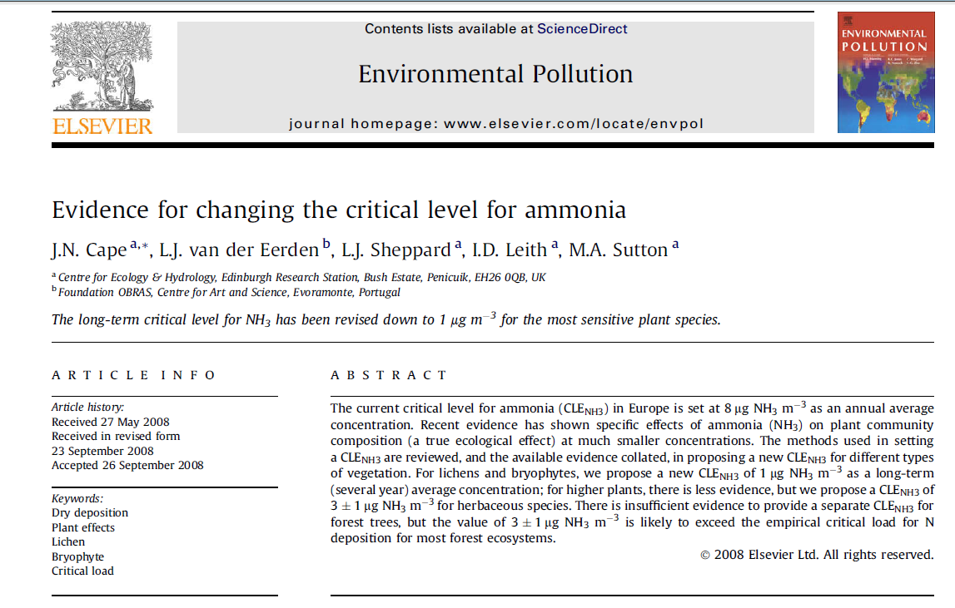
Science underpinning 1µg/m³ / 3µg/m³ critical levels

Slide 32
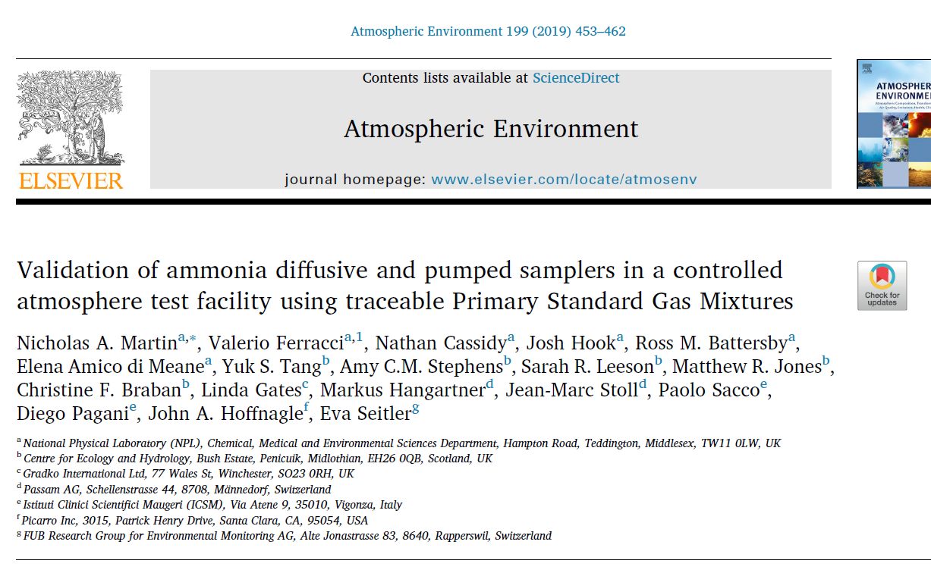
Latest science for monitoring
Paper on the validation evidence for a new EN standard for NH₃ measurements

Slide 33
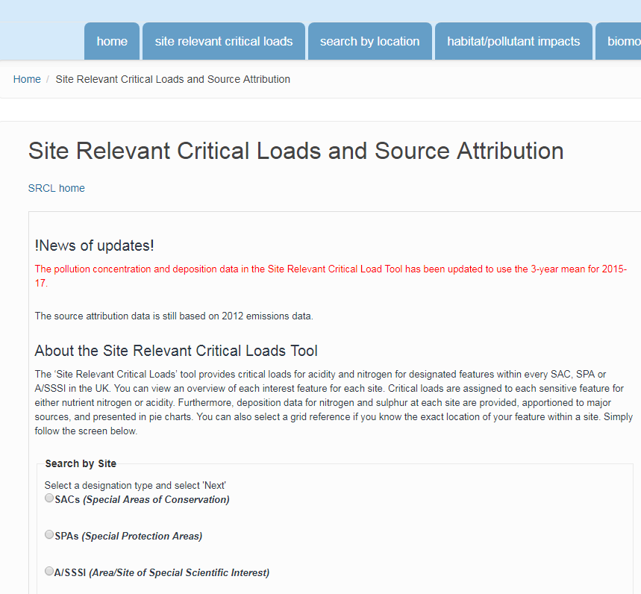
APIS and in combination assessments
For in-combination assessments, only new activities since 2017

Slide 34
Thresholds - options
Need to have thresholds backed-up by scientific evidence
Would we detect NH₃/NO₂ if the installation were permitted?
Cement the link between critical loads and levels
Critical loads developed as long-term risk measures and for strategic objectives
Critical levels have a legal precedent - NO₂ and SO₂ in the 2008 Air Quality Directive
Concentrations are easier to measure than deposition
Alignment with other regulatory bodies?
e.g. the 8% average risk-threshold derived from NECR210?
e.g. 0.1% as a de minimis – because it is statistically close to zero?

Slide 35
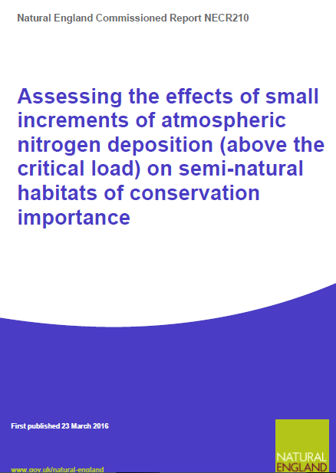
The origin of the 8% additional load
Decades of research – incremental increases of N resulting in no further loss of species
Different values as a percentage of critical load, depending on habitat type
8% is an average increment

Slide 36
The need for a strategic approach

Slide 37
Ammonia headroom
National emissions not on track to meet 2020/30 targets in Gothenburg Protocol
National limits
Many habitats above their critical levels and loads
Local headroom

Slide 38
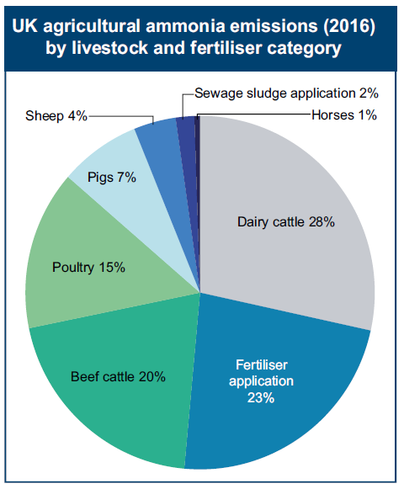
Agricultural emissions by sub-sector
Pigs and poultry farms reported to emit less than ¼ of ammonia emissions from livestock. EA regulates less than ¼ of these, although these are the largest intensive farms

Slide 39
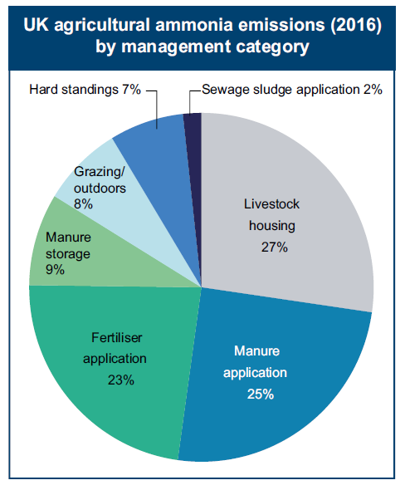
Agricultural emissions by activity

Slide 40
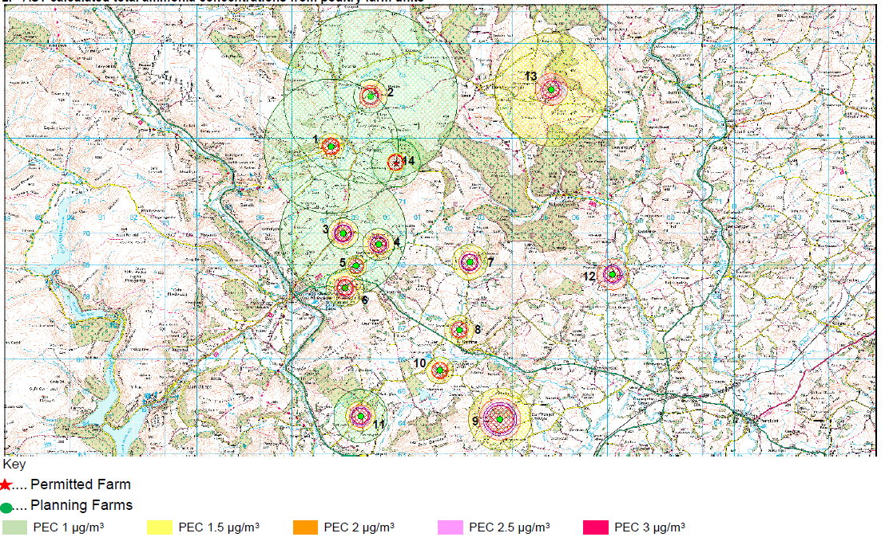
Local headroom, and clusters in combination
Source: NRW

Slide 41
Strategic approach
Proposals in the Clean Air Strategy 2019
Intensive beef and dairy farming to be brought into permitting
Requirements for application of manure/slurry – precision farming
Specifications for chemical fertilisers an option
Need to consider sub-IED intensive farms, with a potentially significant impact?
Most broiler intensive farms fall under the IED
Most egg-layer intensive farms are not under the IED
Food-strategy and socio-economic factors
We all have to eat

Slide 42
Summary
We need to reduce national emissions further to meet legally-binding targets
We need to reduce impacts locally in a cost-effective and efficient manner
Benefit in revisiting and align thresholds amongst regulatory bodies
We will not reduce national NH₃ emissions by focusing all attention on a few individual sectors
Strategic, habitat-centric approach could achieve this
Follow Dutch and Danish examples of how to make this work

